Slide 1
2020
Semi-supervised classification with graph convolutional networks
Kaka

Slide 2







Oct. 2018 - now
Kaka Lin
Software Engineer, Inventec
vn503024@gmail.com
May 2018 & July 2018 & Dec. 2018
TA, Google MLCC Trainer Camp
TA, Google AI Boot Camp
TA, Google AI Teacher Camp
Jan. 2017 - Oct. 2018
Software Engineer, Fara
Nov. 2015 - Dec. 2016
Mechanical Engineer, Fara
Sept. 2013 - Aug. 2015
M.S., BioIndustrial Metronics Eng., NTU
Sept. 2009 - June. 2013
B.S., Vehicle Eng., NTUT

Slide 3
Outline
01
02
Fast Approximate Convolution of Graphs
Smoothness Assumption
03
Example
04
Result

Slide 4
Smoothness Assumption

Slide 5
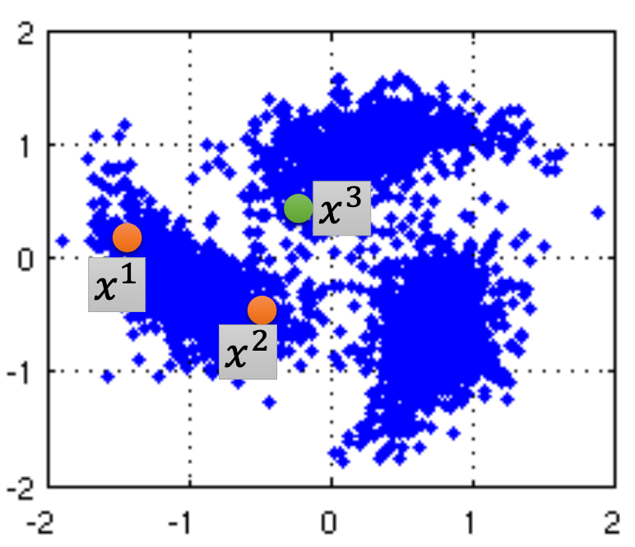
01 Smoothness Assumption
Assumption: similar x has the same y
More precisely:
x is not uniform.
If x1 and x2 are close in a high
density region.
y1 and y2 are the same.
Connected by a high density path
http://hips.seas.harvard.edu/files/pinwheel.png

Slide 6
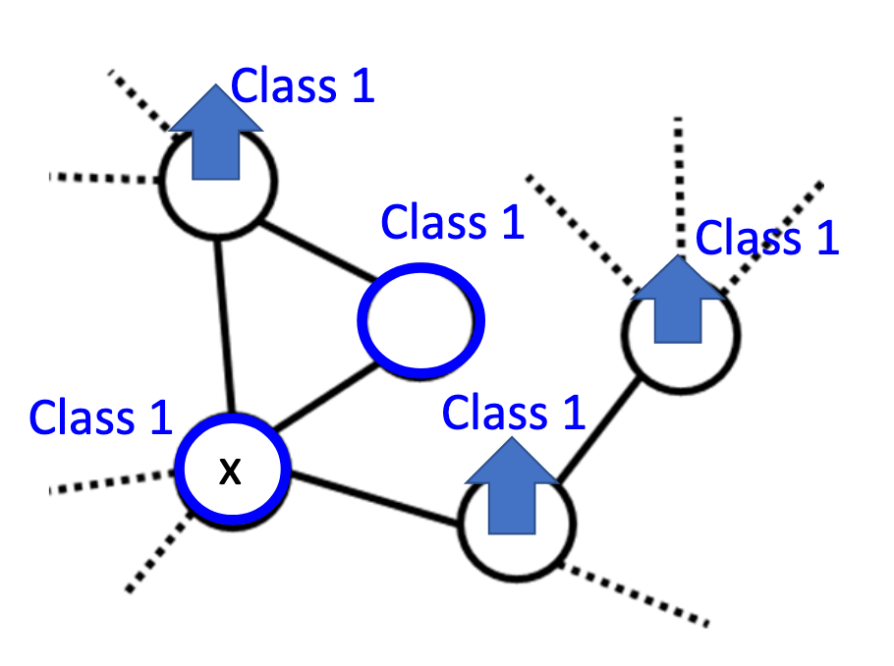
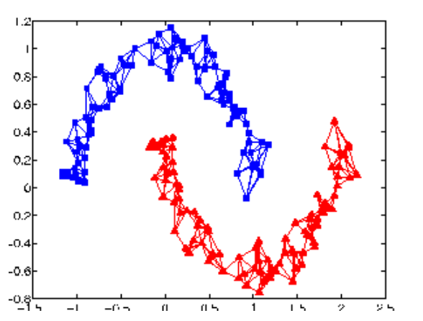
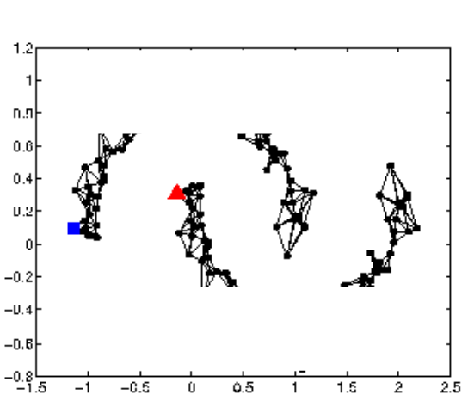
01 Smoothness Assumption
The labeled data influence their neighbors.
Messagepropagate through the graph

Slide 7
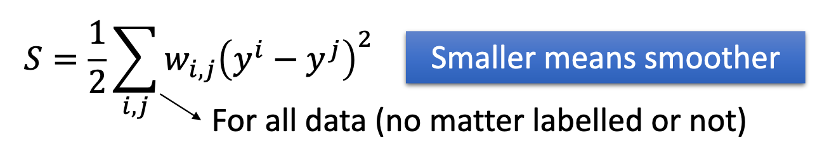
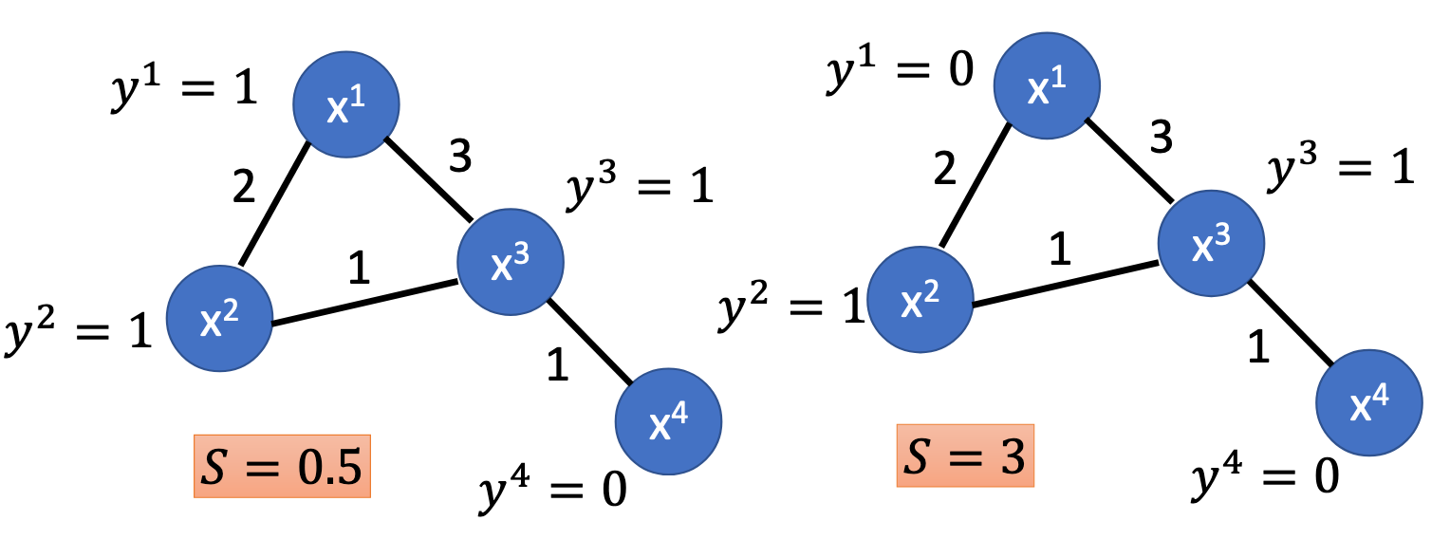
01 Smoothness Assumption
Define the smoothness of the labels on the graph.

Slide 8
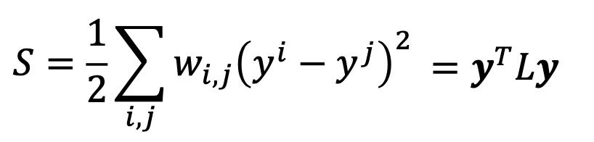
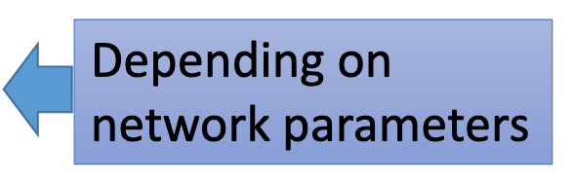
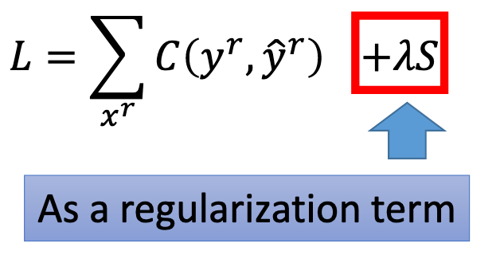
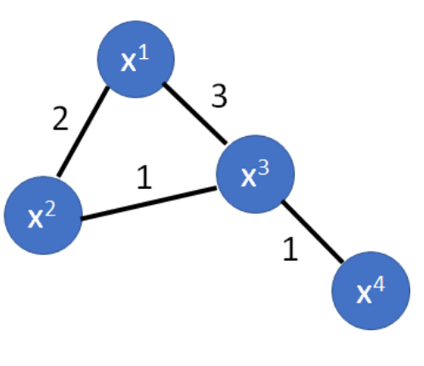
01 Smoothness Assumption
Define the smoothness of the labels on the graph.

Slide 9
01 Smoothness Assumption
Lo: the supervised loss w.r.t. the labeled part of the graph G = (V,E)
∆ = D−A: unnormalized graph Laplacian of an undirect graph.
A: Adjacency matrix.
D: Degree matrix.

Slide 10
Fast Approximate Convolution of Graphs

Slide 11




02 Fast Approximate Convolution of Graphs
Layer-wise propagation rule for a multi-layer GCN
A: adjacency matrix
I_N: identity matrix (self-connections).
W(l): layer-specific trainable weight matrix.
𝝈 : activation function, such as ReLU().
H(l): the matrix of activations in the l_th layer.

Slide 12



02 Fast Approximate Convolution of Graphs
Spectral Graph Convolution
We consider spectral convolution on graph defined as the multiplication of a signal x with a filter 𝑔𝜃 = 𝑑𝑖𝑎𝑔(𝜃) parameterized by 𝝷 in the Fourier domain:
First Generartion GCN
U: the matrix of eigenvectors of the normalized graph Laplacian.
Λ: diagonal matrix of its eigenvalues.
U^T · x : graph Fourier transform of x.
Compute complexity:
we can understand 𝑔𝜃 as a function of the eigenvalues of L, i.e. 𝑔𝜃(Λ)

Slide 13
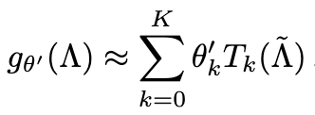
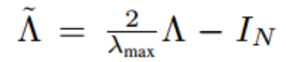

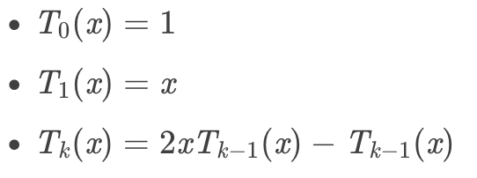
02 Fast Approximate Convolution of Graphs
Spectral Graph Convolution
𝑔𝜃(Λ) can be well-approximated by a truncated expansion in terms of Chebyshev polynomials Tk(x) up to Kth order:
λmax: the largest eigenvalue of L.
theta: vector of Chebyshev coefficients.

Slide 14
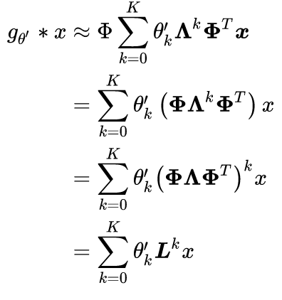
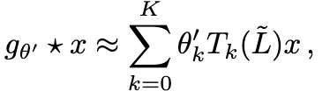


02 Fast Approximate Convolution of Graphs
Spectral Graph Convolution
Second Generartion GCN (ChebNet)
Going back to our definition of a convolution
of a signal x with a filter gθ
Note that this expression is now K-localized since it is a Kth-order polynomial in the Laplacian, i.e. it depends only on nodes that are at maximum K steps away from the center node (Kth-order neighborhood).
Compute complexity:

Slide 15
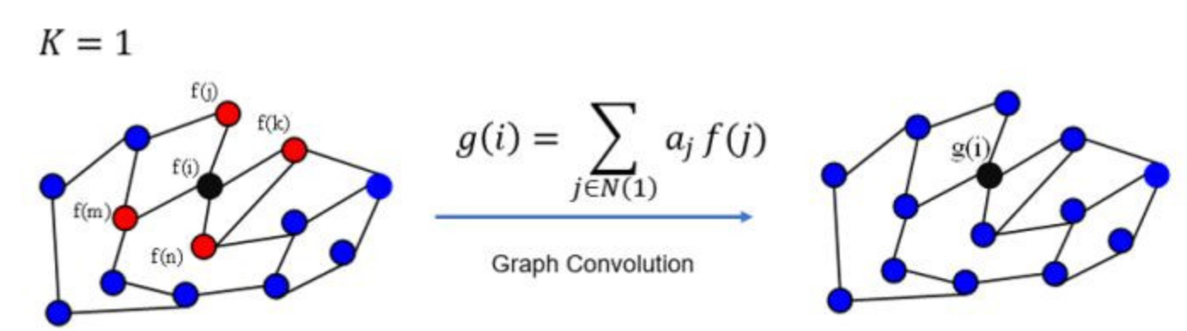
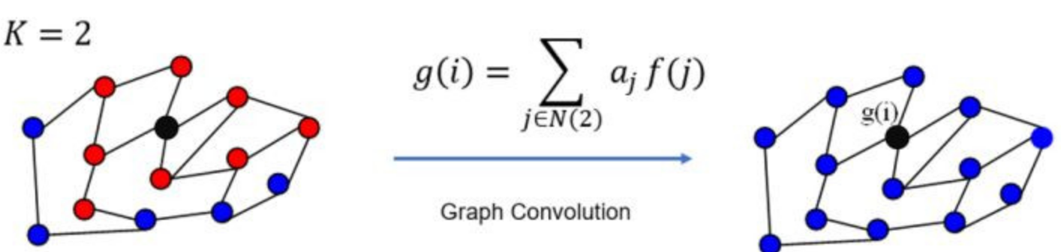
02 Fast Approximate Convolution of Graphs
Spectral Graph Convolution
Second Generartion GCN (ChebNet)
Going back to our definition of a convolution
of a signal x with a filter gθ

Slide 16


02 Fast Approximate Convolution of Graphs
Layer-Wise Linear Model
Third Generartion GCN (First order of ChebNet)
limited the layer-wise convolution operation to K = 1 (function becomes linear) and λmax≈2
That is, each layer only considers the direct neighborhood, similar to the 3x3 convolution kernel on CNN.
has eigenvalues in the range [0.2].

Slide 17




02 Fast Approximate Convolution of Graphs
Layer-Wise Linear Model
Third Generartion GCN (First order of ChebNet)
We have two problem:
Haven't consider the eigenvalue of the node itself
Lead vanishing/exploding gradient when used in a deep neural network.
exploding gradient: when the node connected many nodes.
vanishing gradient: otherwise.
Use renormalization trick: self-connected

Slide 18

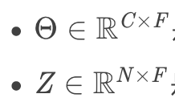

02 Fast Approximate Convolution of Graphs
Layer-Wise Linear Model
Third Generartion GCN (First order of ChebNet)
We can generalize this definition to a signal X (NxC) with C input channels
and F filters or features maps as fellows:
Θ: a matrix of filter patameters.
Z: convolved signal matrix.
Compute complexity:

Slide 19
Example

Slide 20





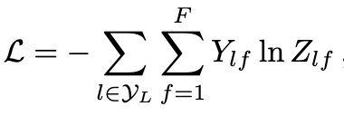
03 Example
We consider a two-layer GCN for semi-supervised node classification on a graph with a symmetric adjacency matrix A (binary or weighted).
First calculate
Forward model
Cross-entropy error:
W0: an input-to-hidden weigth matrix.
W1: an hidden-to-output weight matrix.

Slide 21
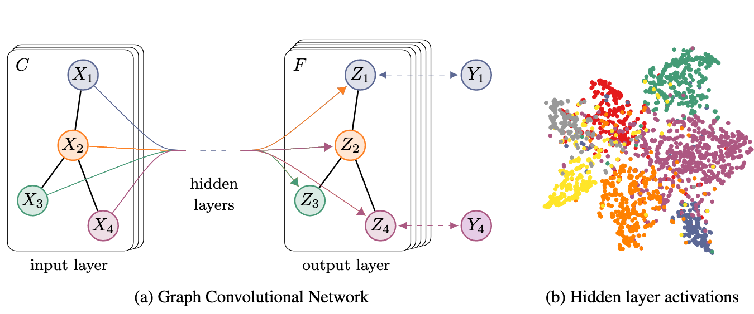
03 Example

Slide 22
Result

Slide 23
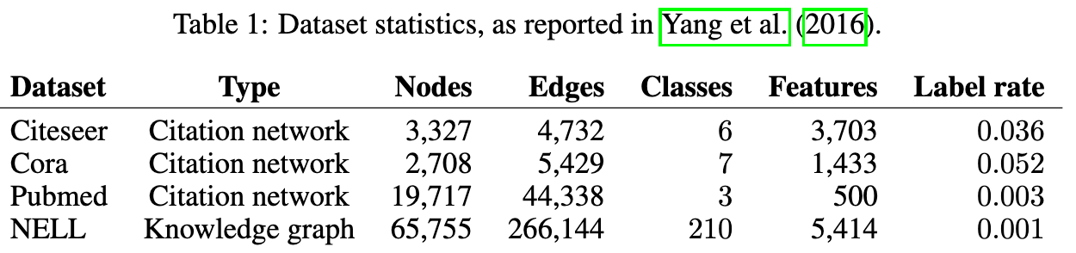
04 Result
Datasets
semi-supervised document classification in citation networks.
semi-supervised entity classification in a bipartite graph extracted from a knowled gegraph.
Citeseer, Cora, Pubmed: nodes are documents and edges are citation links.
Notes:
nodesare documents and edges are citation links.

Slide 24
04 Result
Experimental setup
Model: two-layer GCN.
Compare model: 10 layers model.
Test set: 1000 labeled examples.
Validation set: 500 labeled examples for hyperparameter optimization.
dropout rate for all layers.
L2 regularization factor for the first GCN layer.
number of hidden units

Slide 25
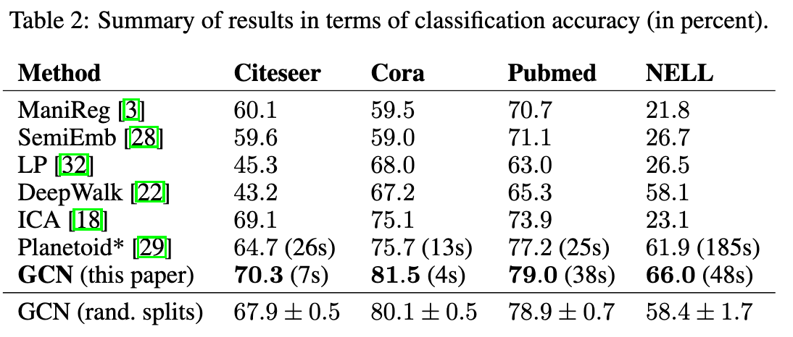
04 Result
Result

Slide 26
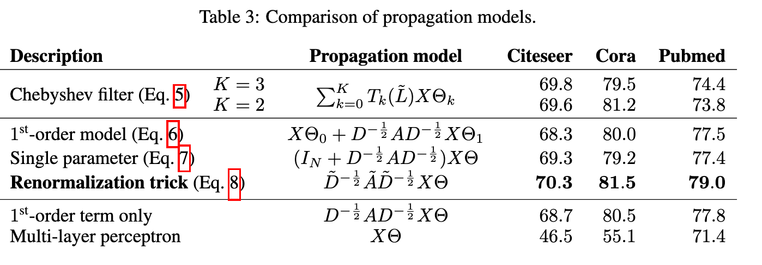
04 Result
Result
We compare different variants of our proposed per-layer propagation model
on the citation network datasets.

Slide 27
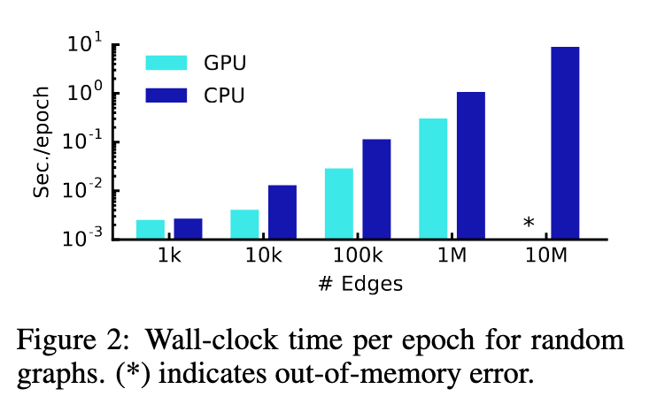
04 Result
Training time per epoch

Slide 28

04 Result
Limitations and Future work
Memory requirement
Directed edges and edge features
This model does not support edge features
Limited to undirected graphs
Limiting assumptions
For some datasets, It might be beneficial to introduce a trade-off
parameter λ in the definition of hat_A:

Slide 29

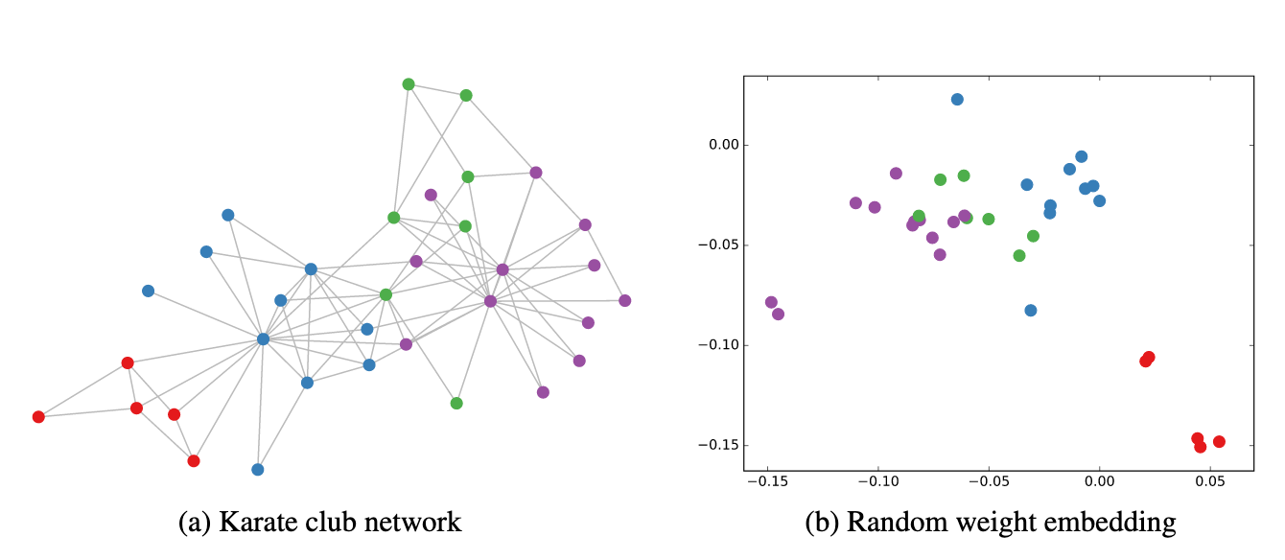
04 Result
Node embeddings with random weights
As an example, consider the following 3-layers GCN model:

Slide 30

04 Result
Semi-supervides node embeddings

Slide 31
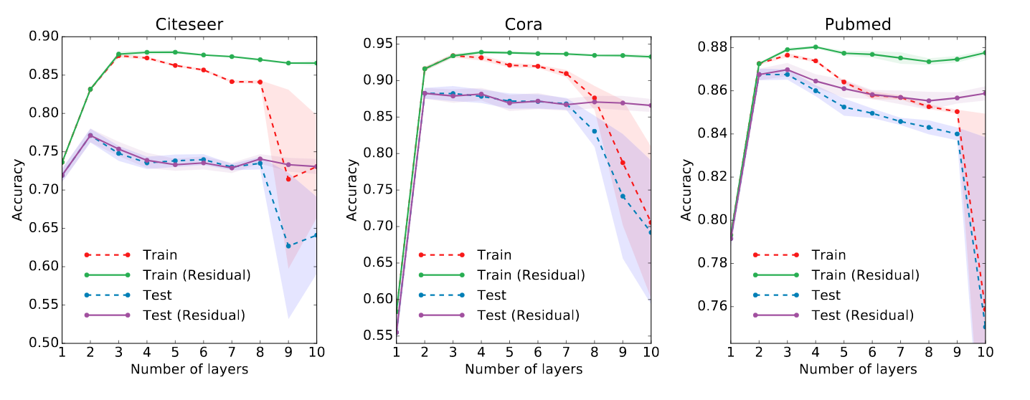
04 Result
Experiments on Model depth
2 or 3 layer model is good!!!

Slide 32
THANK YOU

